Slide 1
A Journey with Data -Advanced Excel
BNU-HKBU
United International College

Slide 2
Outline
Functions
round
left, right, leftb, rightb, mid
datedif
if
vlookup
sumif
iferror
2/58

Slide 3
Vocabulary
Axis: 轴
Filter: 过滤器
Highlight: 突出显示
Polynomial: 多项式
Range: 范围
Scatter: 散点
Tick: 打勾
Trend: 趋势
3/58

Slide 4
Outline (cont.)
Operations
hide and unhide
filter
conditional format
chart editing
trend line generation
4/58

Slide 5
How to Practice
Learn the usage of each function and operation.
Finish all the tasks in the file budget.xlsx.
Submit the finished file budget.xlsx on iSpace.
5/58

Slide 6
Functions
ROUND
LEFT, RIGHT, LEFTB, RIGHTB, MID
DATEDIF
IF
VLOOKUP
SUMIF
IFERROR
6/58

Slide 7
ROUND
Round function
Syntax
Purpose
Round number
digits > 0: round to the right of decimal point
digits = 0: round to the nearest integer
digits < 0: round to the left of the decimal point
ROUND(number, digits)
number (required): the number to be rounded
digits (required): the number of digits to round the value number
7/58

Slide 8


ROUND
Round function
Example
round to the nearest integer
digits=1
digits=0
digits=-2
round to the first decimal point
round to the
multiple of 100
8/58

Slide 9
Task 1
In the budget.xlsx file,
process the data in the column “Actual budget” by removing decimal places and then put the results in the column “Actual Budget with decimal places removed (Task 1)”
9/58

Slide 10


LEFT
Left function
Syntax
Purpose
To extract the characters from the leftmost part of the text.
Example
LEFT(text, [num_chars])
text (required): the text string that is to be extracted from
num_chars (optional): the number of characters to extract (default: 1).
10/58

Slide 11


LEFTB
Leftb function
Syntax
Purpose
To extract the bytes from the leftmost part of the text.
Example(compare LEFT and LEFTB)
LEFTB(text, [num_bytes])
text (required): the text string that is to be extracted from
num_bytess (optional): the number of bytes to extract (default : 1)
Each Chinese character has two bytes.
11/58

Slide 12
Right, Rightb, Mid
Similar functions
Right
Rightb
Mid
12/58

Slide 13
Task 2
In the budget.xlsx file,
process the data in the column “Department” by keeping only the first three letters and put the results in the column “Dept. with three letters (Task 2) ”
13/58

Slide 14
DATEDIF
Datedif function
Syntax
Purpose
To calculate the days, months or years between two dates
units = “Y”: number of years
units = “M”: number of months
units = “D”: number of days
DATEDIF(start_date, end_date, [units])
start_date (required): start date
end_date (required): end date
units (optional): the type of returned info.
14/58

Slide 15


DATEDIF
Datedif function
Example
Date can be entered as text or date(2014, 3, 18)
15/58

Slide 16
Task 3
In the budget.xlsx file,
Calculate the days left from each application date to the end of the year and put the results in the column “Days to the end of year(Task 3) ”. Here year is 2017.
Note: if the date format in the file is not a US date format, select date, right click mouse, choose “Format Cells”, change the location to English (U.S.), and then choose the date format in the form “dd/mm/yyyy”.
16/58

Slide 17
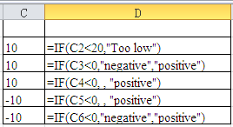
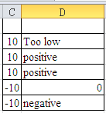
IF
If function
Syntax
Purpose
If condition is true, perform s1, else perform s2.
Example
IF(condition, [s1], [s2])
condition (required): can be true or false
s1 (optional): a formula.
s2 (optional): a formula.
17/58

Slide 18
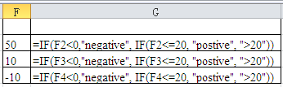
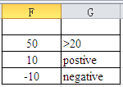
IF
If function can be nested
Syntax
Example
IF(condition, s1, s2)
condition (required): can be true or false
s1, s2 can be an if function themselves.
Condition
s1
s2
18/58

Slide 19
Task 4
In the column “Cost Overrun (Task 4) ” of the budget.xlsx file,
if the actual budget is smaller than or equal to the planned budget, put “OK”
if the actual budget is greater than the planned budget and the difference is not over $1000, put “light”
if the actual budget is greater than the planned budget and the difference is over $1000, put “severe”.
19/58

Slide 20
VLOOKUP
Vlookup function
Syntax
Purpose
Look up value in range and return a matched value in col_index in range
match=true : approximate match
match=false : exact match.
VLOOKUP(value, range, col_index, [match])
value (required): value to look up
range (required): range where to look up the value
col_index (required): column to contain the returned value
match (optional): true or false (default: true).
20/58

Slide 21
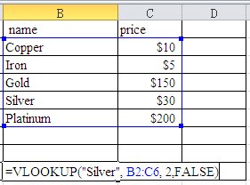
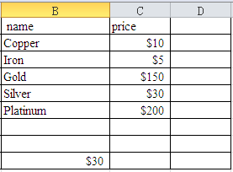
VLOOKUP
Vlookup function
Example 1
21/58

Slide 22
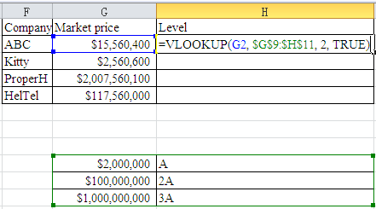
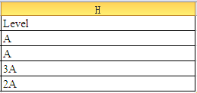
VLOOKUP
Vlookup function
Example 2
Auto Fill
Range: absolute referencing
22/58

Slide 23
Task 5
In the column “Budgets Levels (Task 5) ” of the budget.xlsx file, if the planned budget is
no smaller than $50,000, put “very high”
between $10,000 and $50,000, put “high”
between $2,000 and $10, 000, put “middle”
between $0 and $2,000, put “low”
23/58

Slide 24
SUMIF
Sumif function
Syntax
SUMIF(range, criteria, [sum_range])
range (required): the range to be evaluated with criteria.
criteria (required): criteria to evaluate data in range
sum_range (optional): the range that values will be added
24/58

Slide 25
SUMIF
Sumif function
Purpose
If sum_range is omitted
Add the values in range which satisfy criteria
Otherwise
Add the values starting from the left-upper cell of sum_range
The number of added values is determined by the size of range
Only the value whose corresponding data in range satisfying criteria are added.
25/58

Slide 26
SUMIF
Sumif function
In this practice, assume range contains only one column.
Students can learn the case where range contains more columns after class
26/58

Slide 27
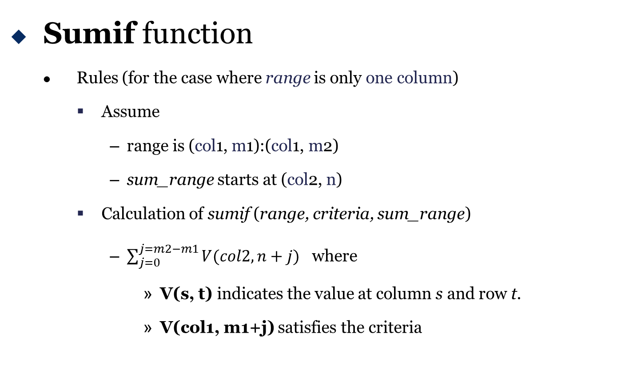
SUMIF
Sumif function
Rules (for the case where range is only one column)
Assume
range is (col1, m1):(col1, m2)
sum_range starts at (col2, n)
Calculation of sumif (range, criteria, sum_range)
$\sum_{j=0}^{j=m2−m1}{V(col2,n+j)}$ where
V(s, t) indicates the value at column s and row t.
V(col1, m1+j) satisfies the criteria
27/58

Slide 28
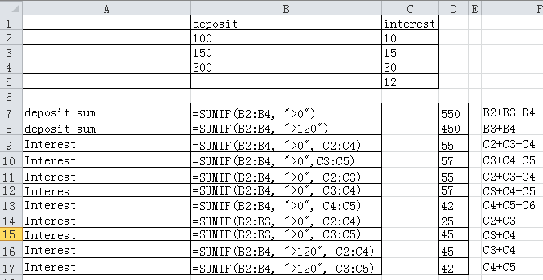
SUMIF
Sumif function
Example (assume s1: size of range, s2: size of sum_range)
Actual
added values
No sum_range
s1=s2
s1>s2
s1<s2
Some values in range do not satisfy criteria
28/58

Slide 29
Task 6
In the budget.xlsx file,
Fill in table 2 with total planned and actual budgets for each department.
Calculate overrun in dollars (e.g., actual - planned) for each department.
Sum up total planned and actual budgets and overrun budgets for all the departments.
Round each sum to be a multiple of 100.
29/58

Slide 30
IFERROR
Iferror function
Syntax
IFERROR(value, value_if_error)
value (required): the value or formula which is to be checked for an error
value_if_error (required): the value to return if the value or formula evaluates to error.
Some common error types:
#DIV/0!
a zero divisor
#VALUE!
a wrong type of argument or operand
#REF!
a non-valid reference in the formula.
#NUM!
a non-valid number to a function argument.
30/58

Slide 31


IFERROR
Iferror function
Purpose
Return value if there is no error; return value_if_error otherwise.
Divisor is 0
Not a number
31/58

Slide 32
Task 7
In the budget.xlsx file,
Calculate (actual budget/planned budget) and put the results in the column “Actual/Planned (Task 7) ”
If the calculation has an error, put the text “No planned ”
32/58

Slide 33
Operations
Hide and unhide
Filter
Conditional format
Edit charts and generate trendline
33/58

Slide 34
Operations
Before the practices of operations, do the following jobs in the budgets.xlsx file
Change the name of current sheet to “Functions ”
Follow the steps below to copy and create a new sheet
Right-click on the sheet name
In the popped-up menu
Under “Move selected sheets to book”, choose “budget.xlsx”. This copies the sheet in the current file
Under “Before sheet”, choose “(move to end)”
Tick “Create a copy ”
Rename the new sheet with name “Practices”
34/58

Slide 35
Operations
Clear Table 2 on the sheet “Practices”
Select the rows and columns in Table 2
Right-click the mouse on the selection
Choose “Clear contents” in the popped-menu
35/58

Slide 36
Operations
Sometimes, the Excel file has many columns and rows.
Only some rows or columns are needed currently.
We can simply hide some rows or columns temporarily.
The hidden rows and columns can be unhidden later.
36/58

Slide 37
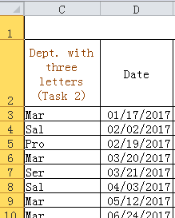
Task 8 (Hide and Unhide)
Hide columns “Department” and “Manager” on the “Practices” sheet
Select column A and B (drag the mouse on the column label)
Right-click on the selection
Choose “Hide” in the popped menu, the columns A and B are hidden
37/58

Slide 38
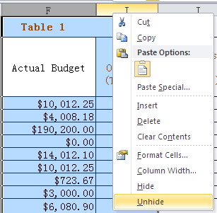
Task 8 (Hide and Unhide)
Use the similar way to hide columns G and H
Unhide G and H
Select F and I and right-click on the selection
Choose “Unhide” in the popped-up menu
38/58

Slide 39
Filter
Sometimes, one column contains several groups or classes of data.
We might need only information for one group.
Filter can extract information for a special group.
39/58

Slide 40
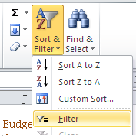
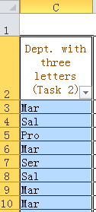
Task 9 (Filter)
Set up filter to see the information for Marketing (Mar) only
Select column C (Starting from the cell “Dept. with three letters ”, this cell is the header)
Under the Home tab, choose “Sort and Filter ”
In the popped menu, choose “Filter ”. The filtering is on (an arrow sign appears in this header of this column).
an arrow
40/58

Slide 41
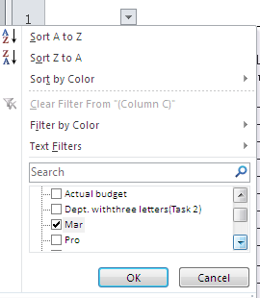
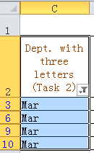
Task 9 (Filter)
Click the arrow and un-tick all the selections except “Mar”.
Click “OK ”. Only rows for “Mar ” are displayed:
41/58

Slide 42
Conditional Formatting
It is very common that some cells that satisfy certain criteria need to be highlighted.
Excel provides multiple ways to highlight cells.
42/58

Slide 43
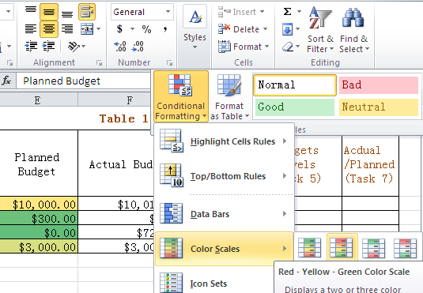
Task 10 (Conditional Formatting)
In the “Practices ” sheet, make the “Planned budgets ” highlighted according to scales.
Select the data part in column E (Planned budgets)
Under the “Home” table, click on “Styles ”
Click on “Conditional Formatting ”
Choose “Color Scales ” from the popped list. Then the data are highlighted based on the scales.
43/58

Slide 44
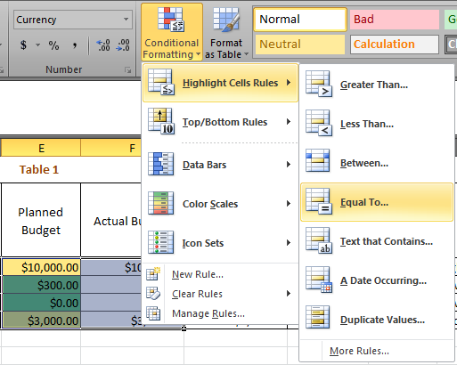
Task 10 (Conditional Formatting)
To highlight budgets which are 0
Select a range from E3 to F10
Choose “Style ” -> “Conditional Formatting ”
In the popped list, choose “Highlight Cell Rules ”, and then “Equal to ”
44/58

Slide 45
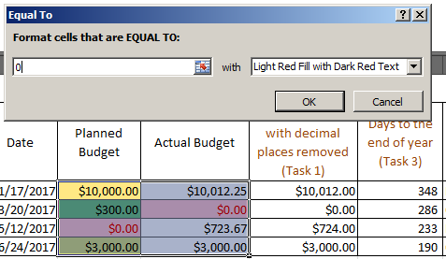
Task 10 (Conditional Formatting)
Enter 0 in the box and then click “OK ”. Only the cells with 0 are highlighted.
45/58

Slide 46
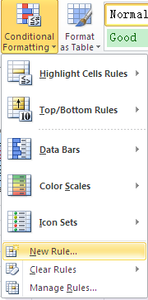
Task 10 (Conditional Formatting)
To highlight the cells where “Planned budgets ” is equivalent to “Actual budgets ”
Select a range from E3 to F10
Choose “Style ” -> “Conditional Formatting ”
In the popped list, choose “New Rule ”
46/58

Slide 47
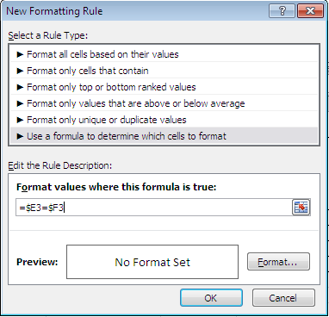
Task 10 (Conditional Formatting)
In the popped “New Formatting Rules ” window, select the rule type as “Use a formula to determine which cells to format ”
Edit rule description by entering “=$E3=$F3”
Absolute
referencing
Relative
referencing
47/58

Slide 48
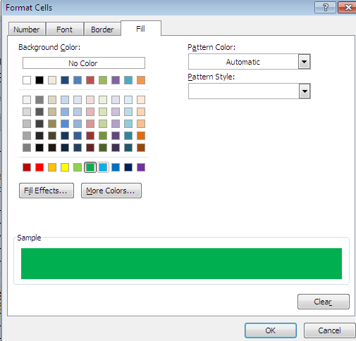
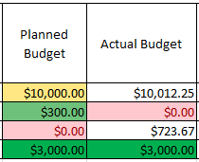
Task 10 (Conditional Formatting)
Click the button “Format ” to choose the background color or other styles, then the “Fill ” tab.
Click on Green color and click “OK ”
Click “OK ” again in the “New Formatting Rules ” window. Then two cells (E10, F10) are highlighted.
48/58

Slide 49
Edit Charts, Generate Trend line and Formula
Charts are very useful to indicate some trends or give statistical data.
A chart can be adjusted to make it clearer.
A trend line can be generated and the corresponding formula can be given.
49/58

Slide 50
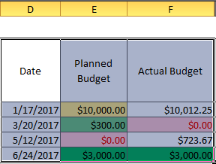
Task 11 (Charts)
Create an XY Scatter chart
Choose three columns and four rows (D2:F10) as shown in the figure.
50/58

Slide 51
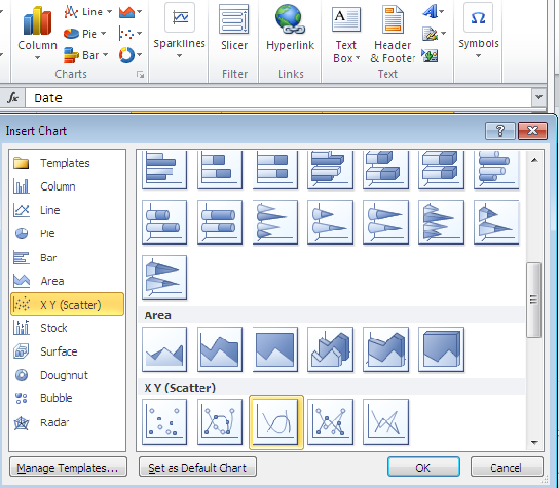
Task 11 (Charts)
Click the arrow at the bottom-right corner of the “Charts” group.
Choose a chart type from “XY (Scatter) ”.
Click “OK ”. Then a chart is displayed.
51/58

Slide 52
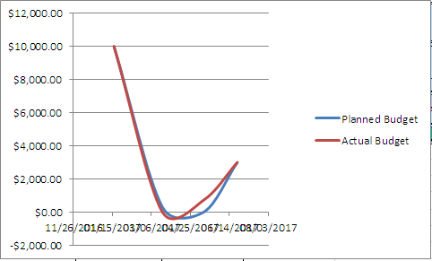
Task 11 (Charts)
In the created chart, the x-axis is in a mess. Follow the steps below to correct it.
Right-click mouse on the dates in the x-axis.
In the popped menu, choose “Format Axis ”.
52/58

Slide 53
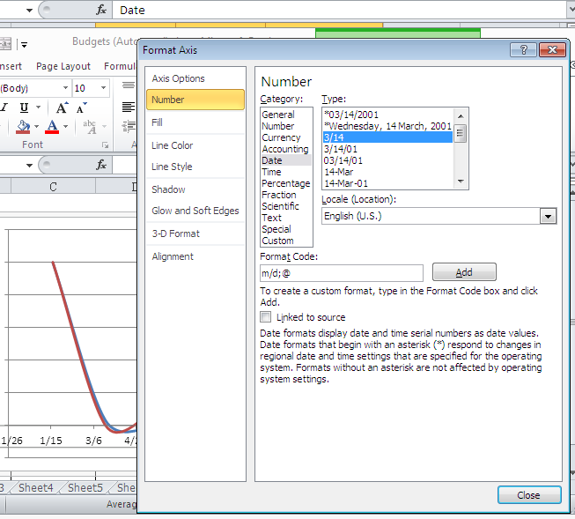
Task 11 (Charts)
In the popped window, choose “Number ”.
Then choose a date format without year.
Click “Close”. The year is removed and the x-axis is clear.
53/58

Slide 54
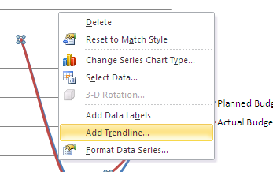
Task 11 (Charts)
Generate a trend line.
Right-click on any point in the red or blue line.
Choose “Add Trendline” in the popped menu.
54/58

Slide 55
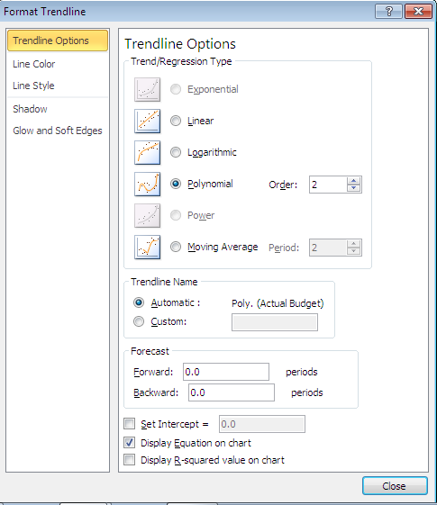
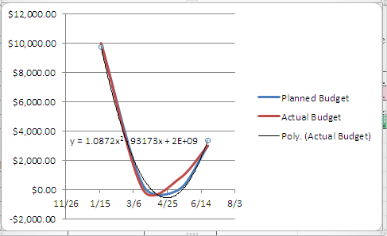
Task 11 (Charts)
Select “Polynomial ” and tick “Display Equation on Chart ”
Click “Close”. A trend line and equation are added.
55/58

Slide 56
End of Practices
Submit budgets.xlsx on iSpace.
56/58

Slide 57
Summary
Learned the usage of functions:
round
left, right, leftb, rightb, mid
datedif
if
vlookup
sumif
iferror
57/58

Slide 58
Summary
Learned the usage of operations:
hide and unhide
filter
conditional format
chart editing
trend line generation
58/58

Slide 59
References and Further Reading
The essential Practice of Information Technology,2nd edition, China Machine Press
ACT Education Solutions, Ltd. Global Assessment Certificate Level II Module11: GAC 011 Microsoft Office 2010[M]. 8th ed. Sydney: ACT Education Solutions, Ltd,2009.

